Slide 1
Session 7
Tree and Ensemble Methods

Slide 2
Agenda
Decision Tree
Random Forest
Ensemble Methods
Fraud detection problem
Doubt resolution

Slide 3
Decision Trees
A decision tree is a supervised machine learning algorithm that can be used for both classification and regression problems.
A decision tree makes a series of sequential decisions made to reach a specific result based on a set of features present in the data
Feature importance and the sequence of attributes are decided on the basis of criteria like Gini Impurity Index or Information Gain, attribute with lowest impurity or higher gain is chosen as root note

Slide 4
Estimation Criterion
Choosing the most useful attribute for classifying examples.
Entropy
A measure of homogeneity of the set of examples
If the sample is completely homogeneous the entropy is zero and if the sample is an equally divided it has entropy of one
Information Gain
Measures how well a given attribute separates the training examples according to their target classification
This measure is used to select among the candidate attributes at each step while growing the tree

Slide 5

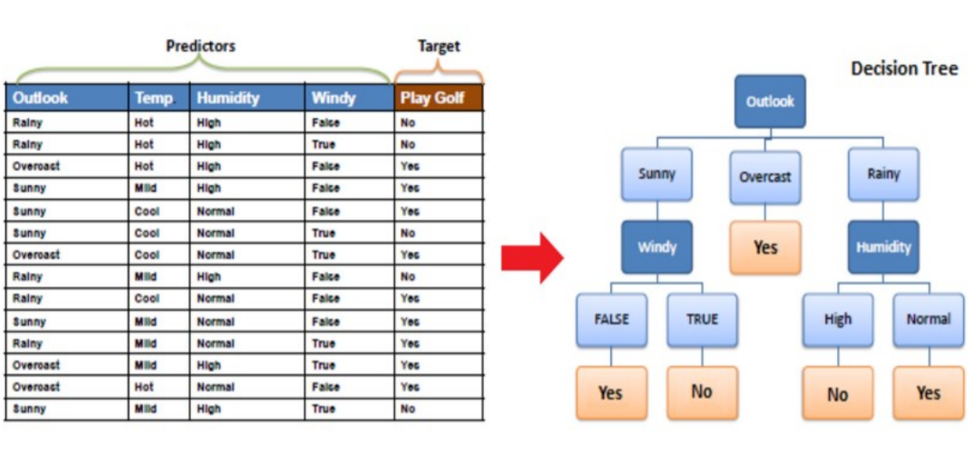

Simple Example

Slide 6
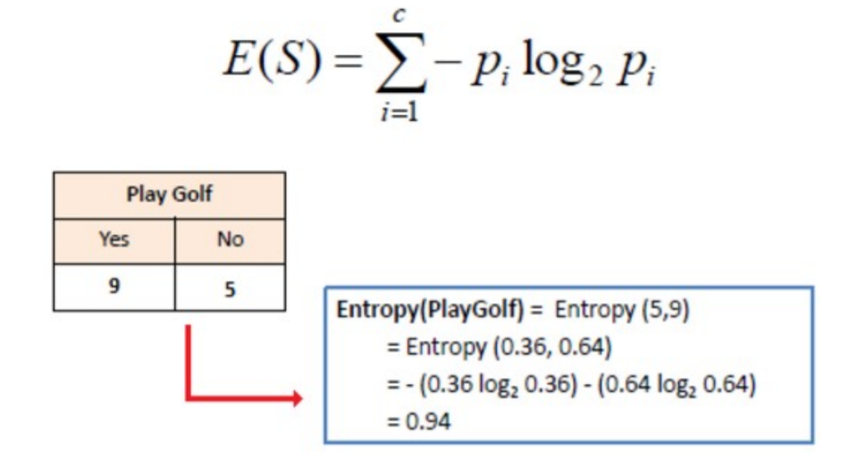
Information Gain
Step 1 : Calculate entropy of the target

Slide 7
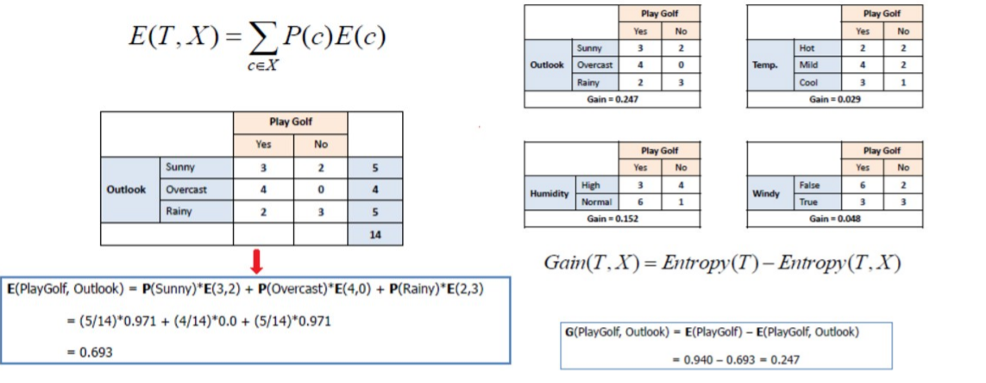
Information Gain (Cont’d)
Step 2 : Calculate information gain for each attribute

Slide 8
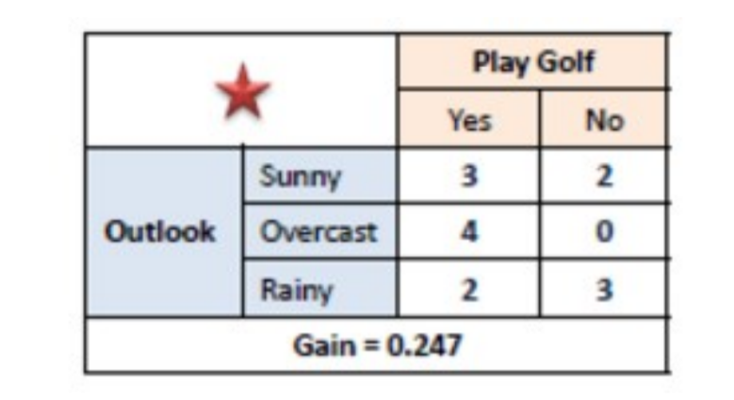
Information Gain (Cont’d)
Step 3: Choose attribute with the largest information gain as the decision node.

Slide 9
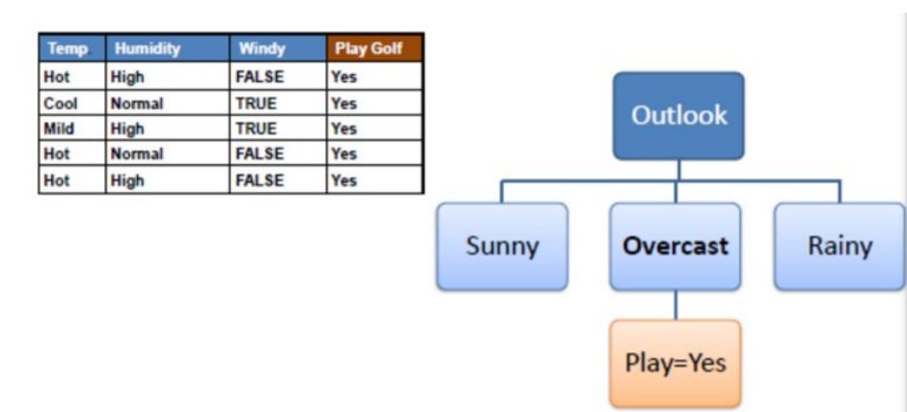
Information Gain (Cont’d)
Step 4a: A branch with entropy of 0 is a leaf node.

Slide 10
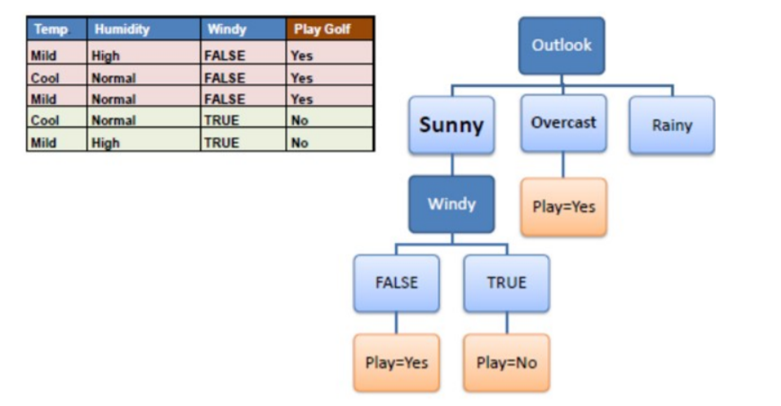
Information Gain (Cont’d)
Step 4b: A branch with entropy more than 0 needs further splitting.

Slide 11
Information Gain (Cont’d)
Step 5: The algorithm runs recursively on the non-leaf branches, until all data is classified.

Slide 12
Random Forest
Random Forest is a tree-based machine learning algorithm that leverages the power of multiple decision trees for making decisions.
Each node in the decision tree works on a random subset of features to calculate the output. The random forest then combines the output of individual decision trees to generate the final output.
In Simple Terms, Random Forest Algorithm combines the output of multiple (randomly created) Decision Trees to generate the final output.

Slide 13
Random Forest pseudocode
Randomly select “k” data points from total “m”.
Where k << m
Among the “k” features, calculate the root node using the information gain.
Split the root node into child nodes.
Repeat 1 to 3 steps until we form the tree with a root node and having the target as the leaf node
Build forest by repeating steps 1 to 4 for “n” number times to create “n” number of trees.

Slide 14
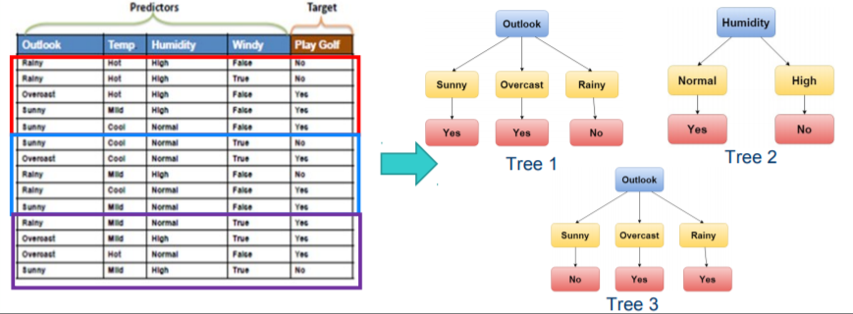
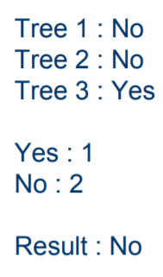
Simple Example

Slide 15
Decision Trees vs Random Forest
The decision tree model gives high importance to a particular set of features. But the random forest chooses features randomly during the training process. Therefore, the random forest can generalize over the data in a better way. This randomized feature selection makes random forest much more accurate than a decision tree.
Decision trees are much easier to interpret and understand. Since a random forest combines multiple decision trees, it becomes more difficult to interpret.
Random Forest has a higher training time than a single decision tree. And collective decision making outperforms single decision making process

Slide 16
Ensemble methods
Use multiple models to obtain better predictive performance
combine multiple fast learners (like decision trees)
Ensembles combine multiple hypotheses to form a better hypothesis
Combine multiple weak learners to produce a strong learner
Typically much more computation, since you are training multiple learners
Note that empirical studies have shown that random forests do better than an ensemble of decision trees
Random forest is an ensemble of decisions trees that do not minimize entropy to choose tree nodes

Slide 17
Bias/Variance Tradeoff
Ensemble methods that minimize variance
Bagging
Random Forests
Ensemble methods that minimize bias
Functional Gradient Descent
Boosting
Ensemble Selection

Slide 18
Questions

